Slide 1
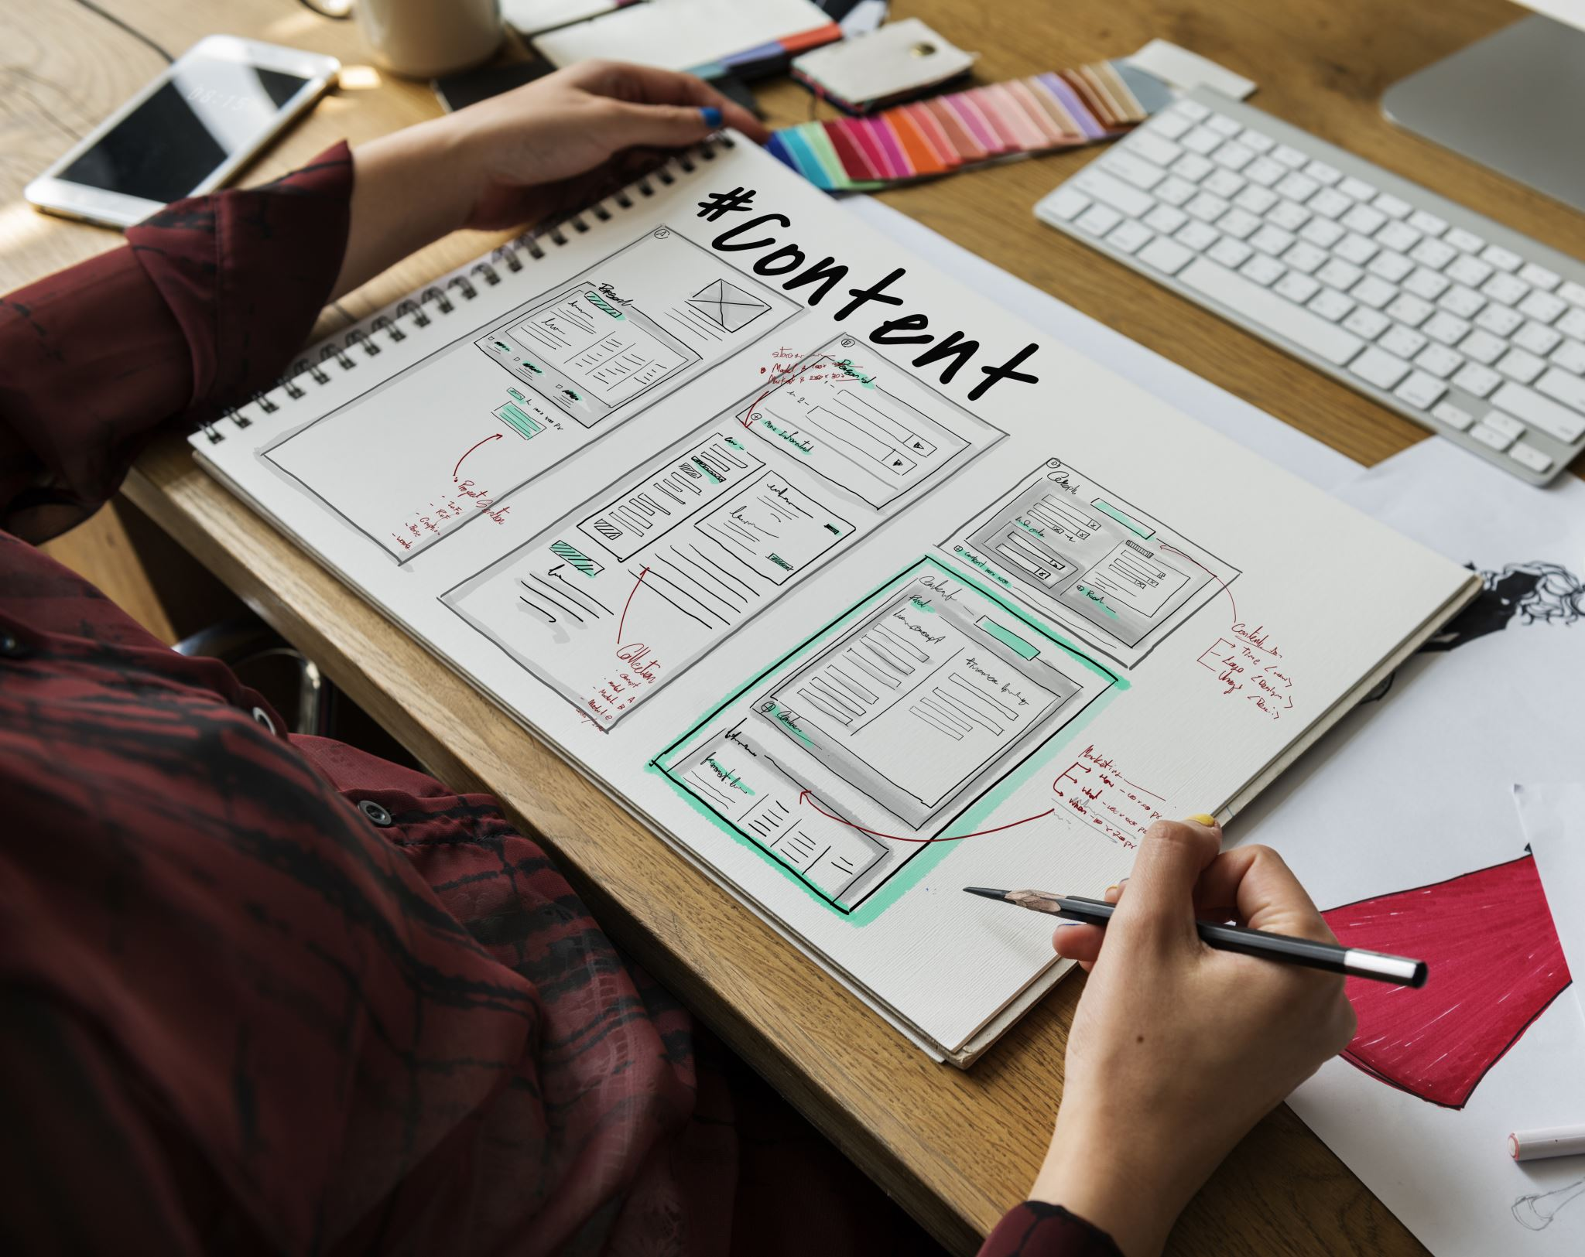
Task Management App
Human-computer interaction project proposal
Presented by: [insert name here] - [insert ID here]
Other Team members:
[insert name here] - [insert ID here]
Mohamed Mostafa Sayed - 22011170
Nour Khaled Mohamed - 22011319
Ali El-Deen Maher - 22010934
[insert name here] - [insert ID here]

Slide 2

Objectives
Using Python-PyQt,
An application that helps users:
Manage their time efficiently using varies study Techniques.
Organize their tasks and categorize them into projects or lists and make schedules.
Set due dates for tasks with Notifications and reminders for upcoming due dates.
Filter tasks by status, priority, or due date.
Track their progress in completing their tasks.

Slide 3
Storage/Database
If it's simple: Using JSON or INI files to store settings and task data is sufficient.
If it's more complex: using SQLite for more structured and relational data storage.

Slide 4
Core Features
Task Management
Task Organization
Due Dates and Reminders
Search and Filter
Study Techniques
Progress Insights & Analytics
Calendar View and create schedules
Progress Tracking

Slide 5

Task Management
Create new tasks with titles and descriptions
Edit existing tasks
Delete tasks
Mark tasks as completed or pending
Set priorities (high, medium, low)

Slide 6
Task Organization
Categorize tasks into projects or lists.
Tagging system for better organization.
Subtasks for breaking down larger tasks.

Slide 7

Due Dates and Reminders
Set due dates for tasks.
Recurring tasks (daily, weekly, monthly).
Notifications and reminders for upcoming due dates.

Slide 8

Search and Filter
Search functionality to find tasks quickly.
Filter tasks by status, priority, or due date.

Slide 9

Study Techniques
Offers a variety of study techniques tailored to boost focus and productivity, including the Pomodoro Technique and more

Slide 10
Progress Insights & Analytics
Provide insights into task completion.
How many tasks are completed by day.
Average completion time, most productive times, etc.

Slide 11

Calendar View and create schedule
Offer a calendar view for a visual representation of upcoming deadlines and events.
Create a schedule for daily, weekly and monthly events.

Slide 12

Progress Tracking
Offer a progress bar or percentage completion for tasks that involve multiple steps or subtasks.

Slide 13
User Interface Features
Customizable Themes:
Light and dark modes.
Option to change color schemes
Drag and Drop:
Reorder tasks using drag and drop
Responsive Design:
Ensure the UI adapts to different screen sizes
Context Menus:
Right-click options for quick actions (edit, delete, mark complete)

Slide 14

Thank you, Ask me something!

